Slide 2
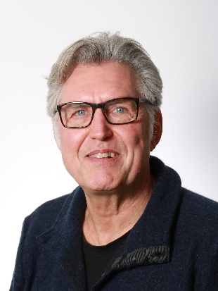
What is sustainability?
Associate professor Stig Irving Olsen

Slide 3
Learning outcomes of the video
Explain the definition of sustainability
Explain the three pillars of sustainability
Explain that our planet is at risk from an environmental perspective and that we consequently need to reduce our impacts

Slide 4
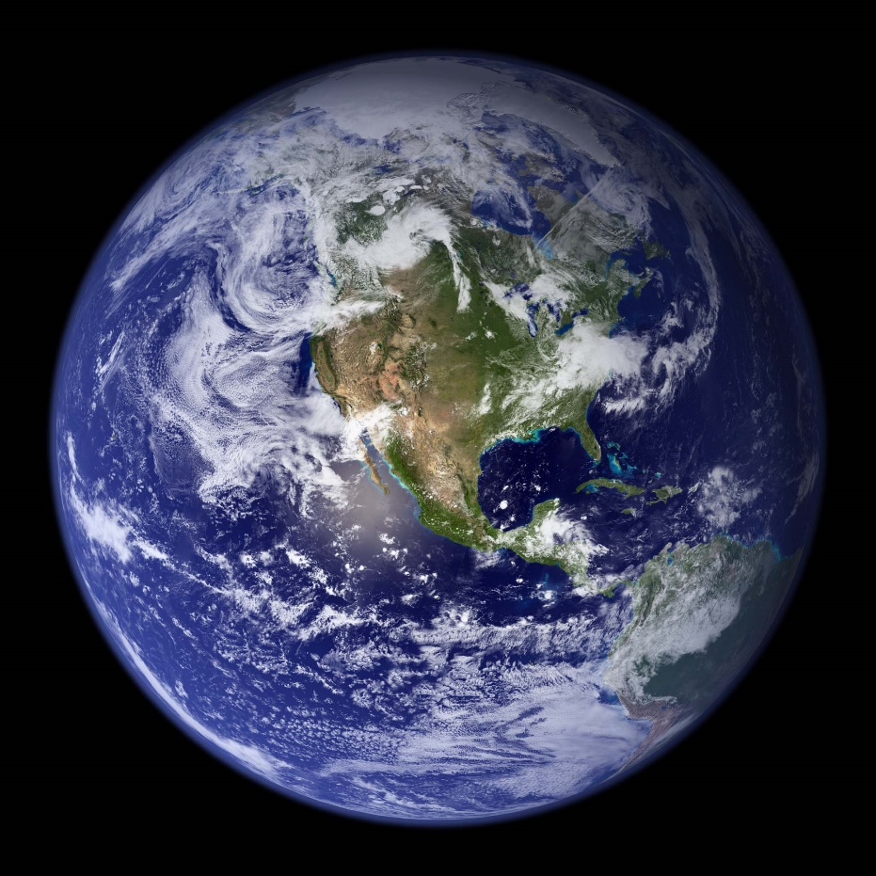
What is sustainability?

Slide 5
Brundtland commission definition
World Commission on Environment and Development’s report from 1987 'Our common future’ (also known a the Brundtland report) defined sustainable development a:
‘Development that meets the needs of the present without compromising the ability of future generations to meet their own needs'
www.simplypsychology.org

Slide 6
Sustainability ?
Earth’s life support system
Three dimensions of sustainability
All three need to be fulfilled to achieve
sustainability
Human societies
Society
Economies
Society
Economy
Economy
Environment
Environment
equitable
bearable
sustainable
viable

Slide 7
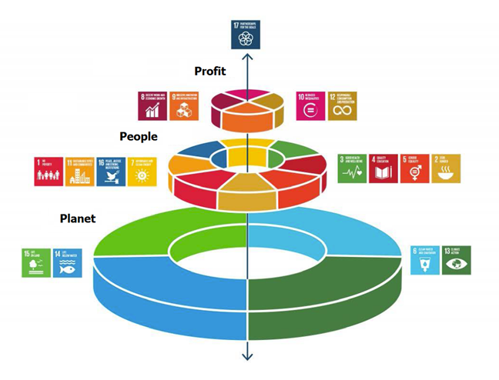
United Nations SDGs
Leadership
Prosperity &
Economy
Social
Environmental

Slide 8
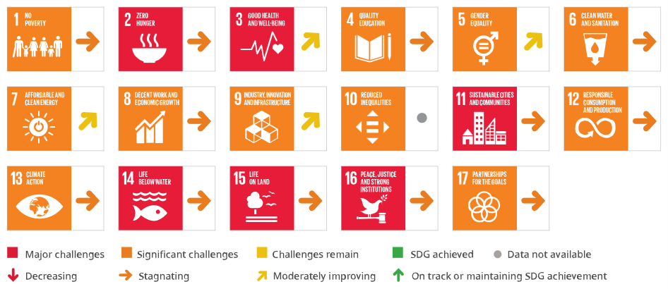
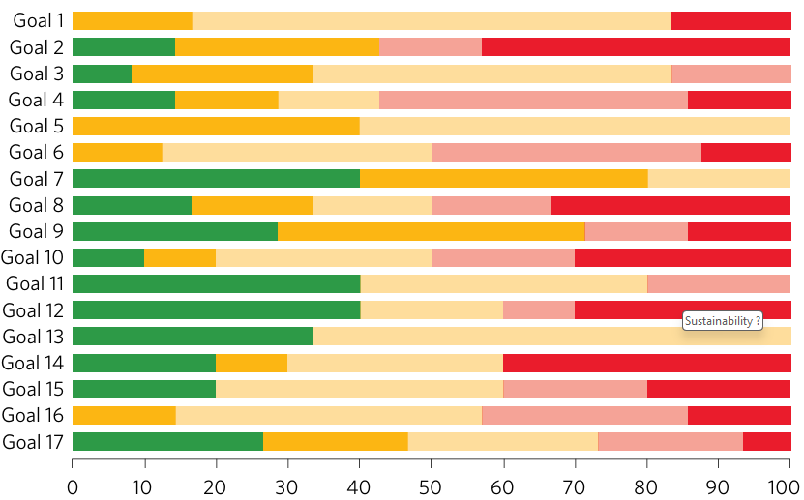
Progress towards the SDGs
https://unstats.un.org/sdgs/report/2025

Slide 9
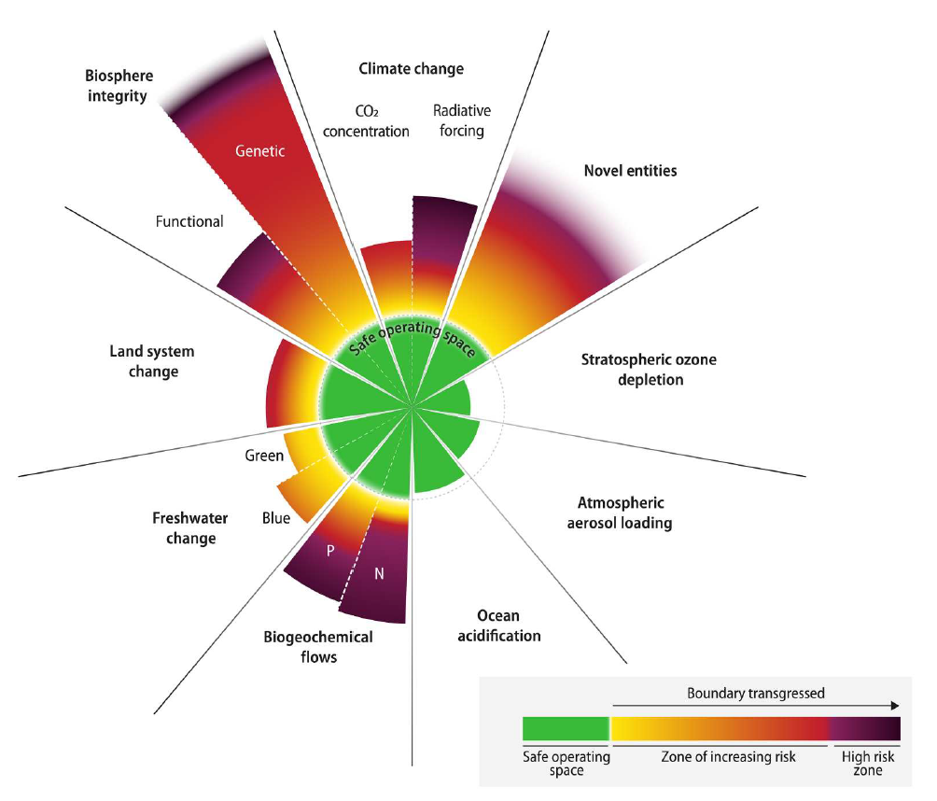
Planetary boundaries
Richardson et al., Sci. Adv. 9, eadh2458 (2023)

Slide 10
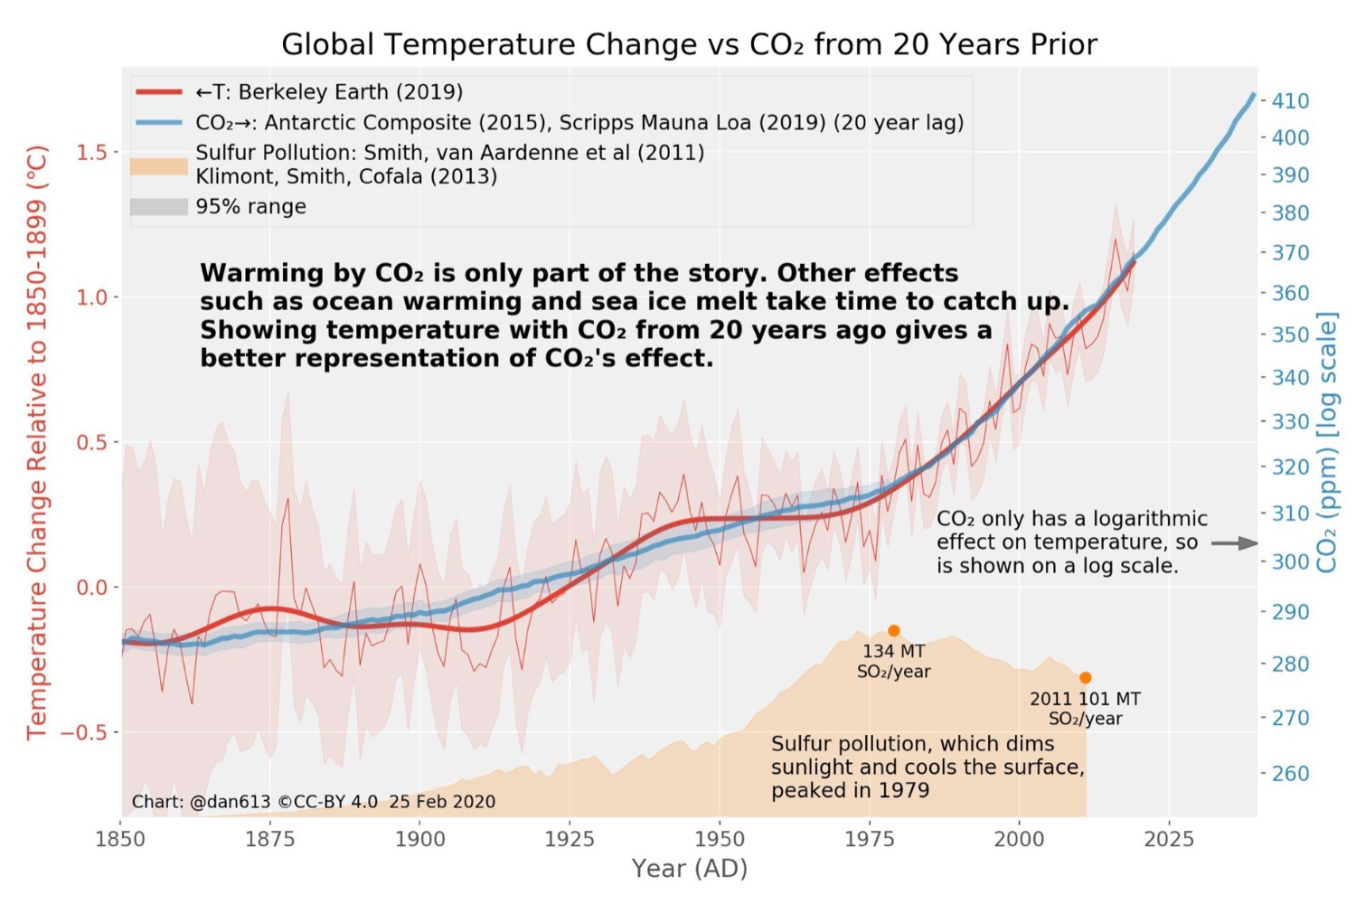

Slide 11
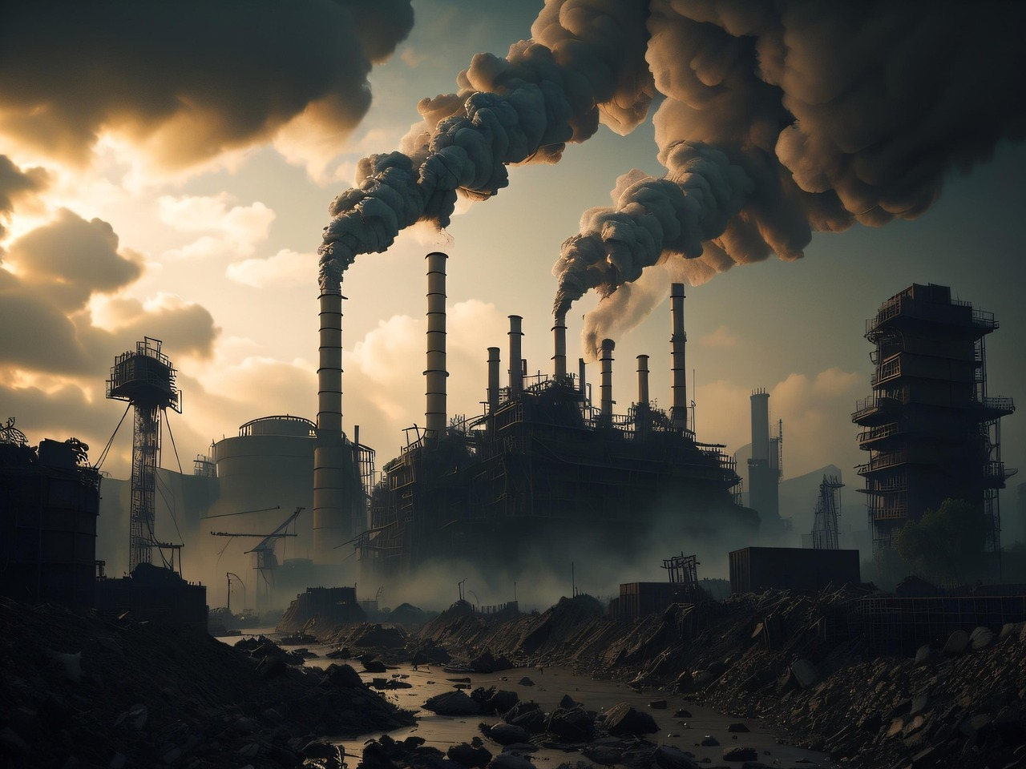
Pollution

Slide 12
PCB in arctic animals
Σ PCB ng/g fat
1.000.000
100.000
10.000
1.000
100
10
1
EC₅₀ Mink (50% survival)
25.000 Seal (reduced reproduc.)
21.000 Rhesus monkey (LOAEL for immunity)
1000 Man (NOAEL, brainfunct.)
500 Man (LOAEL, memory)
Arctic fox
Polar bear
Porpoise
Walrus
White whale
Minke whale
Seal, Greenland-
Seal, common

Slide 13
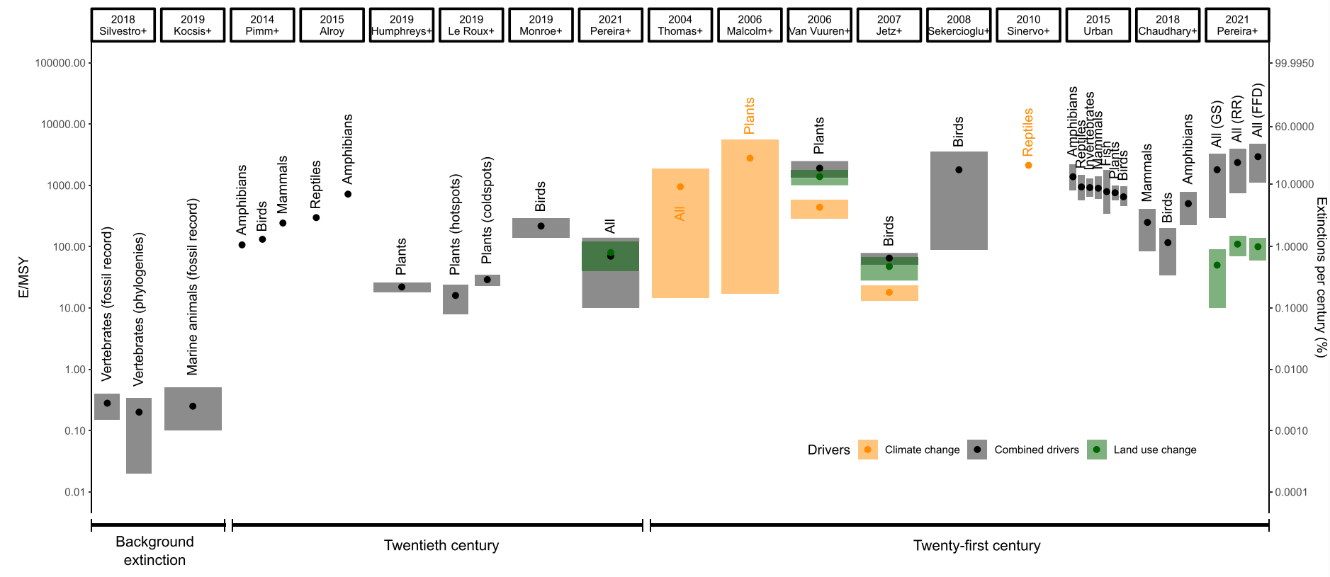
Biodiversity is threatened
(Andréoletti and Morlon, 2023)

Slide 14
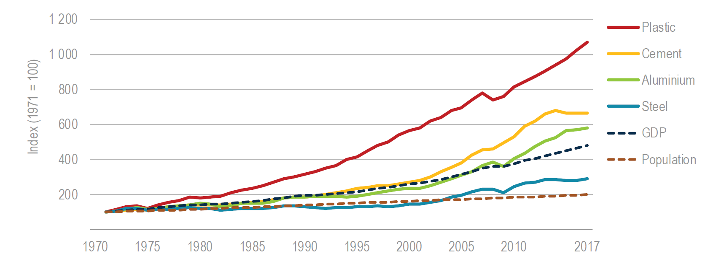
Growth in demand for key materials
Source: IEA (2019): Material efficiency in clean energy transitions

Slide 15
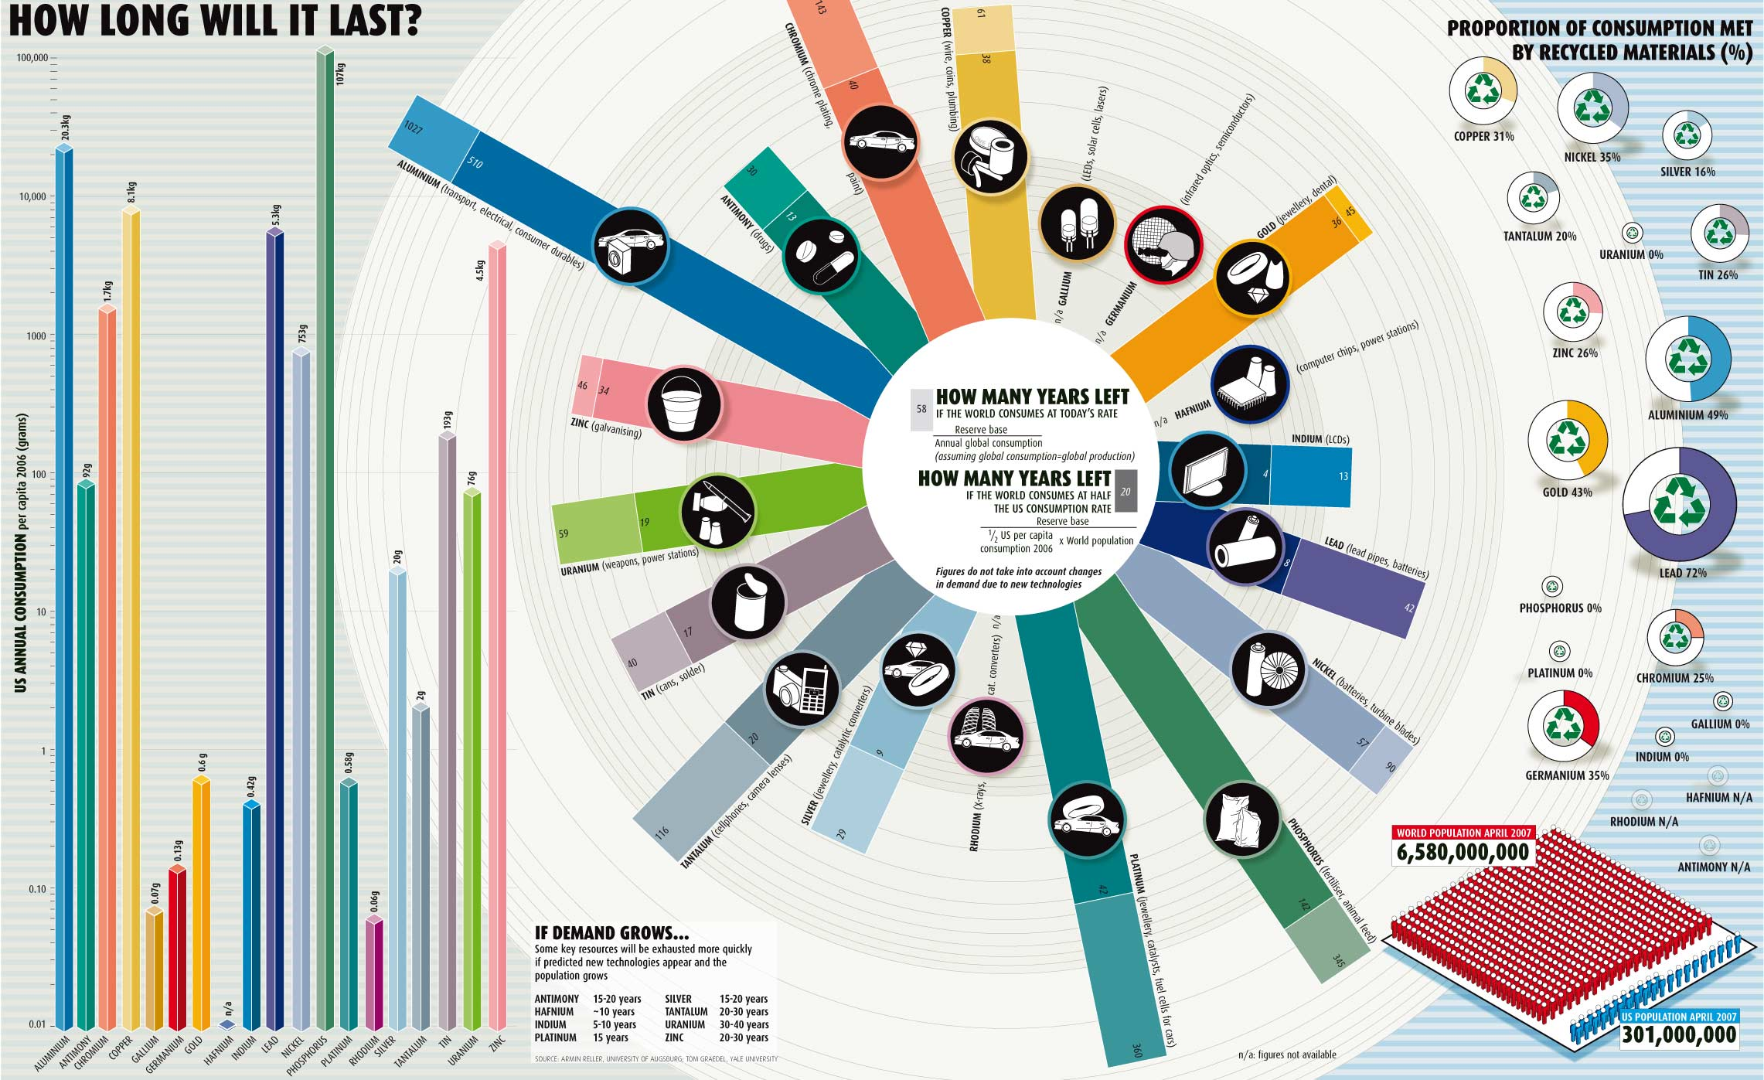

Slide 16
Key take aways
Sustainability assessment should consider three dimensions; social, economic and environmental
The environment is challenged by human activities
We need to reduce our environmental impact to stay within the planetary boundaries

